Slide 1
Mean-Variance Portfolio Rebalancing with Transaction Costs
Author: Philip H. Dybvig
Presenter: Sining Liu

Slide 2
We will go through…….
-Intuition of considering transaction costs
-Different costs
-Theory and model
-Other rebalancing strategies
-Conclusion
-My opinion

Slide 3
Intuition of considering transaction costs
Benefit may not cover the transaction cost of trading
Unprofitable to rebalance to the optimal(ideal) portfolio
Choose not to trade(rebalance)
Non-trading region is created

Slide 4
Different costs
No cost
Variable(Proportional) cost
Fixed cost
-Overall
-Security-specific
Theory and model are based on these 4 types of costs.

Slide 5
Theory and model
Single risky asset
Single period
Mean-variance

Slide 6
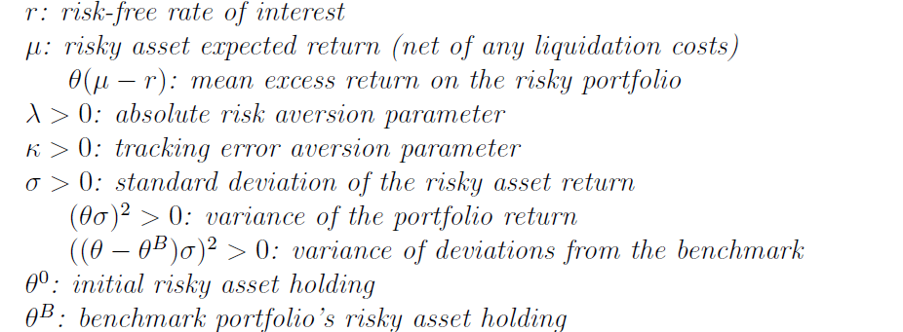
No Cost
Utility Function

Slide 7
No Cost
Ideal position
Without cost, we always rebalance our portfolio to this ideal position.

Slide 8
Variable(Proportional) cost
Utility function

Slide 9
Variable(Proportional) cost
As our intuition suggests, a non-trading region exists:
If our original allocation is within the non-trading region ≤ ≤ we don’t trade.
Outside the non-trading region it is optimal to trade to the boundary of the region.
: Weight in risky asset is too low, we need to purchase
: Weight in risky asset is too high, we need to sell
How to solve for ? -Apply P and S to the utility function.

Slide 10
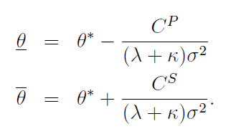
Variable(Proportional) cost
Solve for

Slide 11
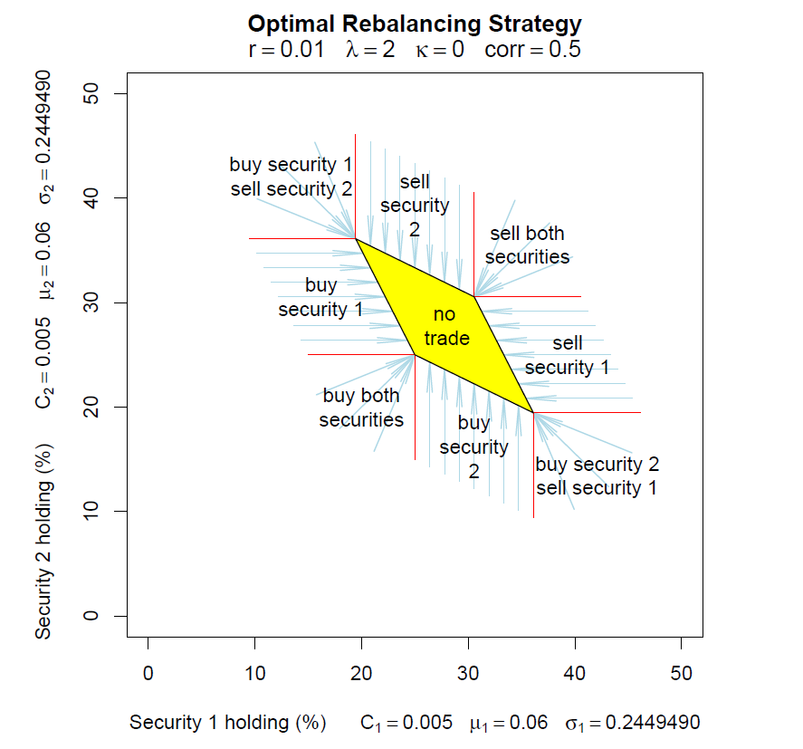
Symmetric
-two securities with same indicators
2. Parallelogram
-correlated, substitutes
3. Square
-uncorrelated
4. K=0

Slide 12
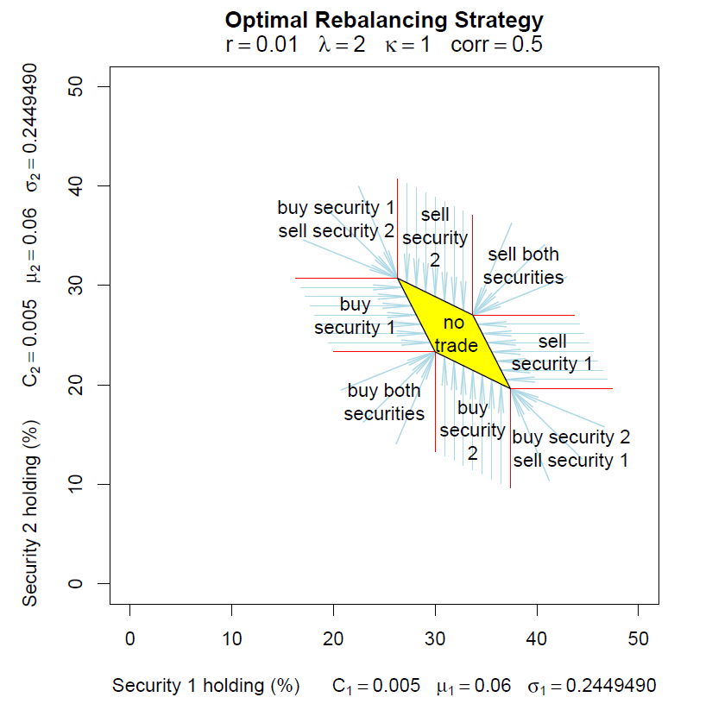
K=1, Penalty on benchmark increases.
Recall that:
Non-trading region shrinks. Similarly:

Slide 13
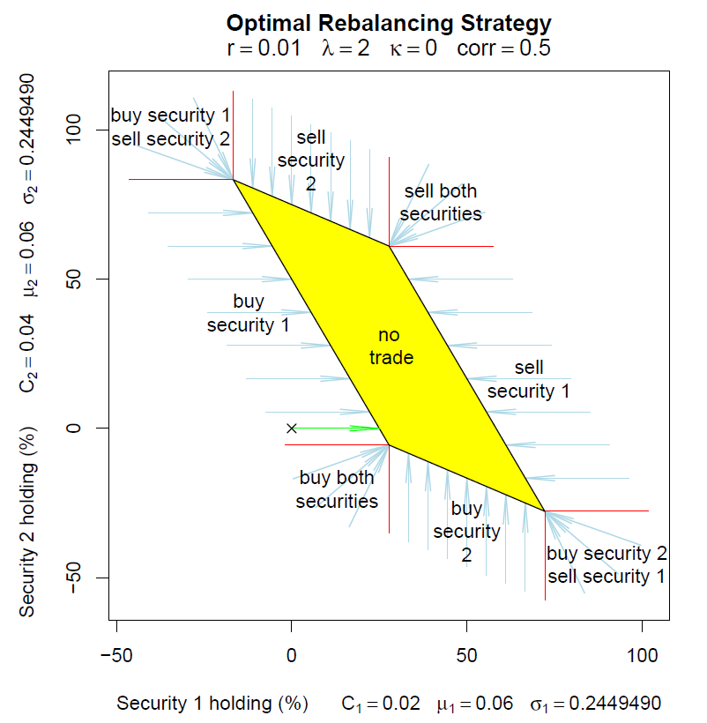
Cost of Security 2 increases.
Recall that:
C increases, non-trading boundaries of Security 2 are wider. Vertical size gets larger. Starting with all cash ( at the x ), the optimal trade forgoes the expensive Security 2 and purchases only Security 1.

Slide 14
Fixed cost-Overall
If we trade, the cost is the same whatever trade we make.
- the same whether you are trading one stock or many
Therefore, if we are going to trade, we always trade to the same ideal portfolio.
Comparison between :
Utility(not trading) and Utility(trading-overall fixed cost)

Slide 15
Fixed cost-Overall
Non-trading region:

Slide 16
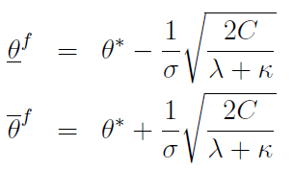
Fixed cost-Overall
Solution for

Slide 17
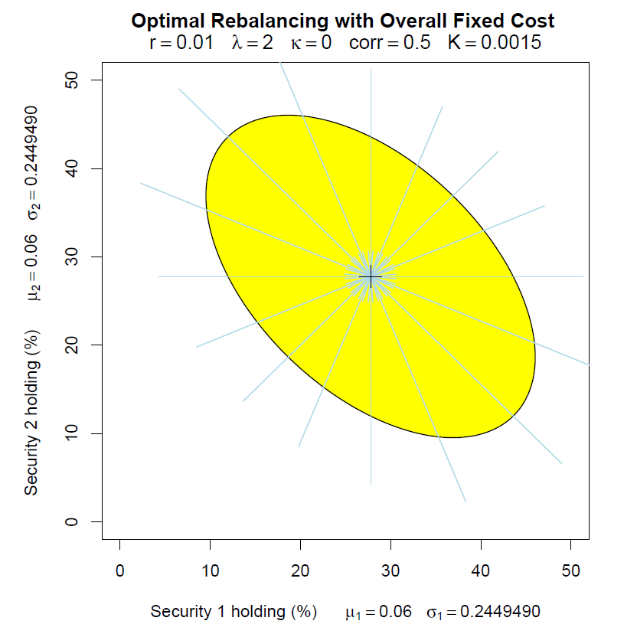
Ellipse
Within non-trading region: no trade
Trading from outside the region is not to the boundary: we trade all the way to the ideal point

Slide 18
Fixed cost-Security Specific
A security-specific fixed cost comes from a due diligence requirement to monitor or document any security in the portfolio.
-look up the ticker code or read some research on the firm
A combination of overall fixed cost and variable cost

Slide 19
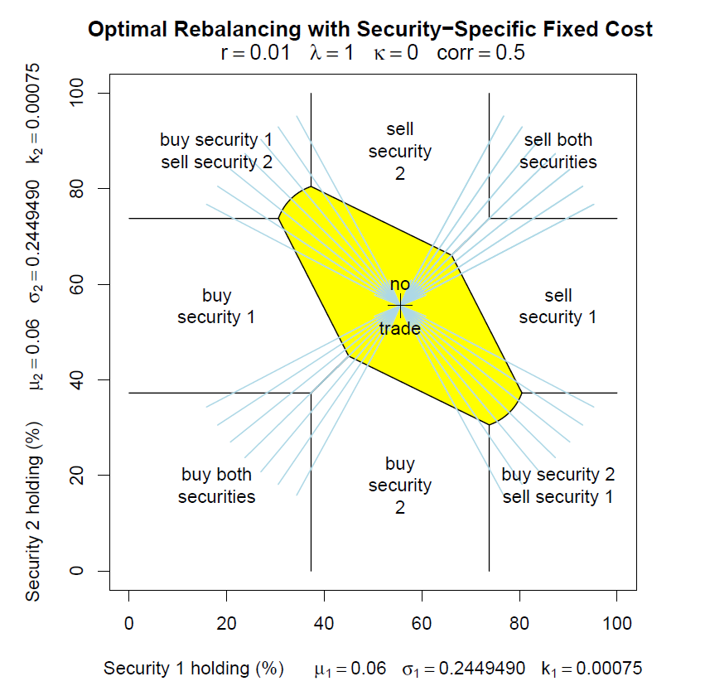
With security-specific costs, it only trades when securities is significantly out of line with the ideal portfolio.
When both securities are traded, it’s optimal to trade to the ideal position.

Slide 20
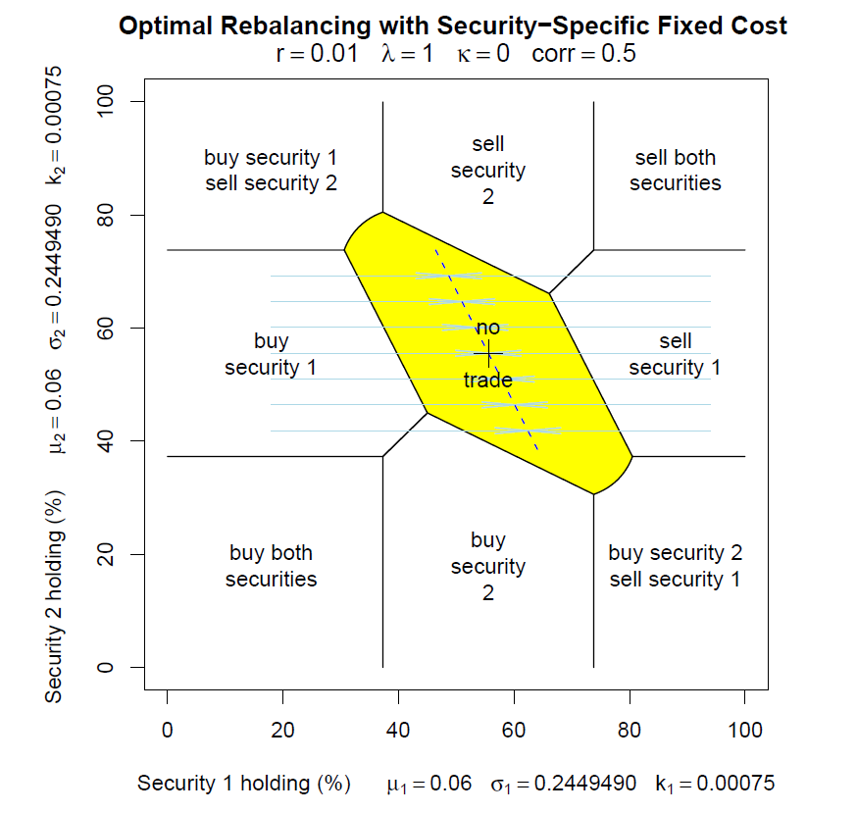
The blue arrows indicate the optimal trades to the ideal point when only Security 1 is traded.

Slide 21
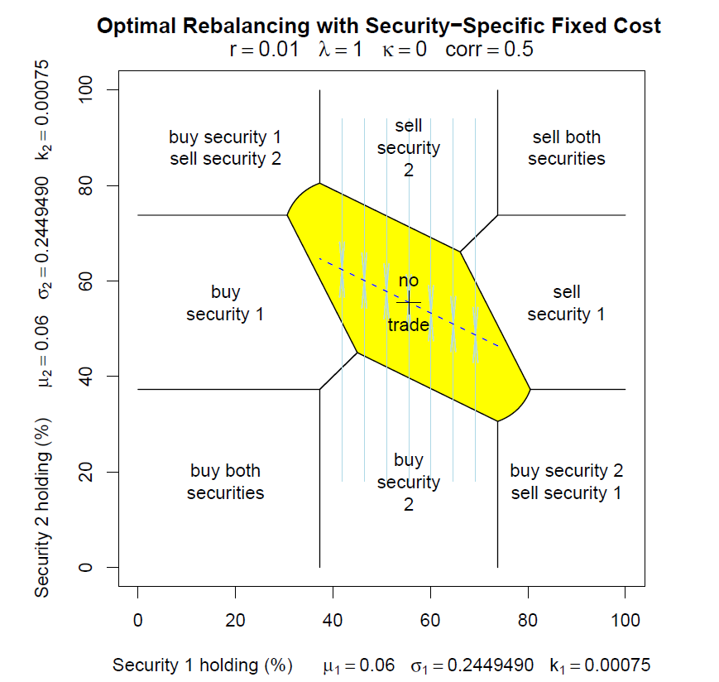
The blue arrows indicate the optimal trades to the ideal point when only Security 2 is traded.

Slide 22
Other rebalancing strategies
1. Futures Overlay
-two examples
2. Bundles Trading

Slide 23
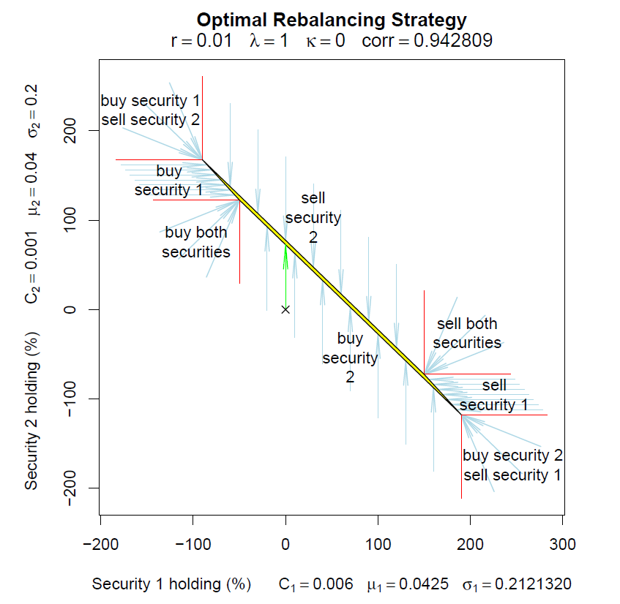
Rebalancing by trading equities is expensive. Futures are highly correlated with equities but much cheaper to trade.
Security 2: Futures
Futures cost less. Vertical size shrinks.
In this case, starting from all cash, the optimal trade is to buy futures only.

Slide 24
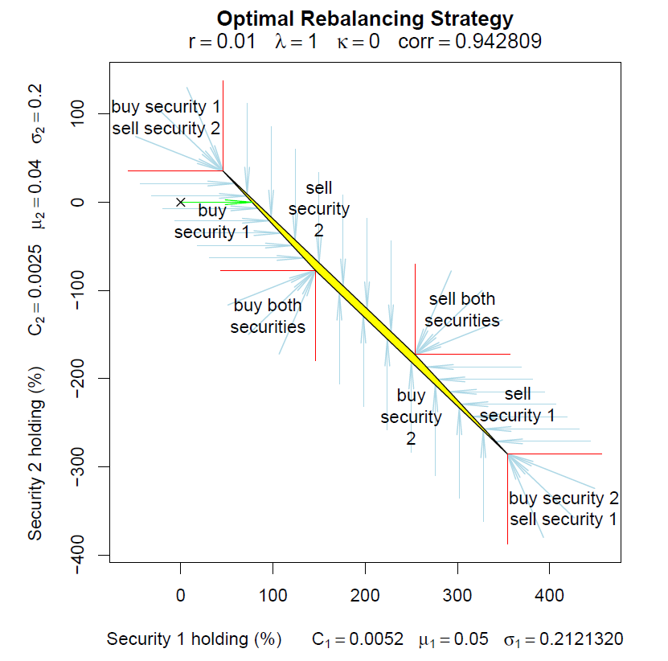
Futures cost less but actual equities(Security 1) has higher expected return (“alpha”).
Higher alpha VS Higher cost to trade
In this case, it’s optimal to buy equities(Security 1) only.

Slide 25
Other rebalancing strategies-Futures
If the market exposure must be reduced, we sell futures, which cost less and help us to keep the extra return on the equities.
If the market exposure must be increased, we buy equities, which have the extra return.

Slide 26
Other rebalancing strategies-Bundles trading
If it is possible to purchase a bundle of securities more cheaply than its constituent securities, then there could be a new non-trading boundary in the problem.
The following figure illustrates an example with the additional opportunity of buying a 50-50 mix of the two securities at a favorable cost.

Slide 27
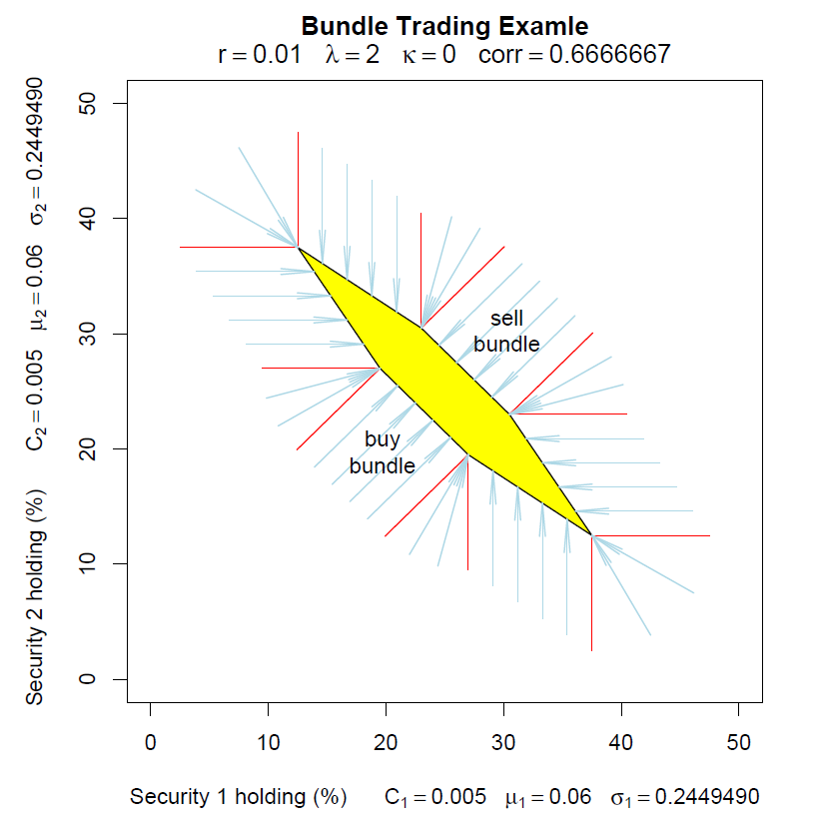

Slide 28
Conclusion
Models with single risky asset and single-period
good intuitions
suggestive of good strategies for more realistic cases(e.g. continuous time period)

Slide 29
My opinion
Logic from single asset and single-period to multiple assets and continuous period
Intuitions and graphs are straightforward
Some concerns about the utility function:
Necessary to include benchmark deviation penalty? Always negative effect?
Utility tends to be underestimated.- is detracted twice
If considering benchmark, terms related to benchmark variance should be added.

